Slide 1
Rhino: Efficient Management of Very Large Distributed State for Stream Processing Engines
By
Likhitha Javvaji
Naveen Reddy Narayana

Slide 2
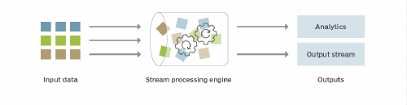
What is Stream Processing Engine?
Stream processing is a data management technique that involves consuming a continuous data stream to quickly analyze, filter, transform or enhance the data in real time.
Once processed, the data is passed off to an application, data store or another stream processing engine.

Slide 3
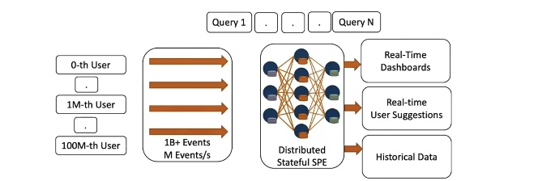
Use case: a real time bidding platform
High-cardinality data stream + long-running stateful queries + large temporal aggregations or joins = Very Large Distributed State

Slide 4
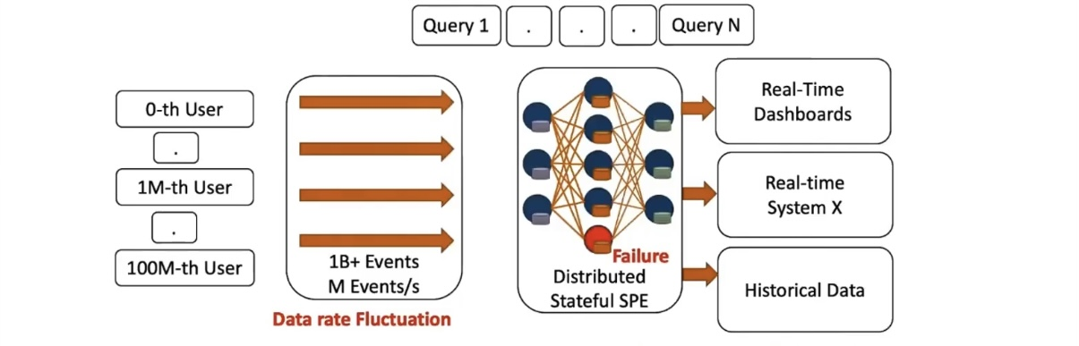
What could go wrong?
Very Large Distributed State + anomalous operational events = slow reconfiguration = high latency + downtime + data loss = DISASTER

Slide 5
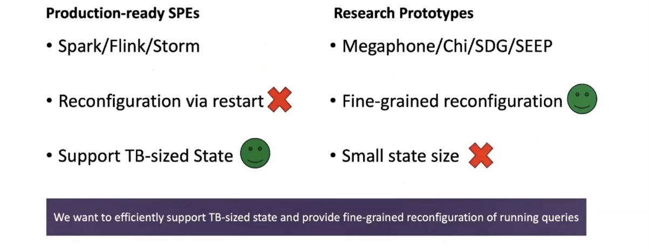
What about current SPEs?

Slide 6
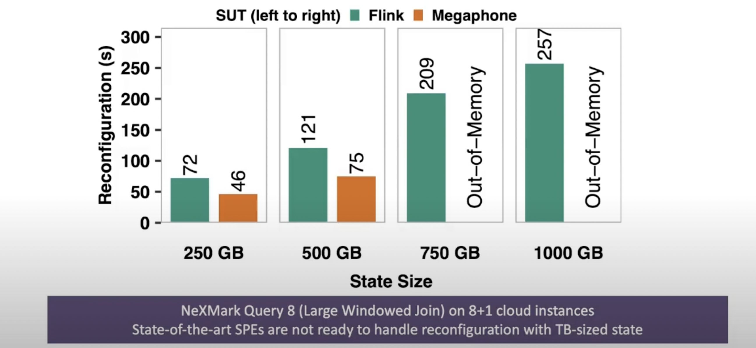
Do we really need yet a new system?

Slide 7
Research Goal
Efficient State Management and on-the-fly Query Reconfiguration in the presence of TB-sized Operator State to support:
Fault-tolerance
Resource Elasticity
Runtime Optimizations
Challenges
Processing overhead: Minimal impact on query processing performance.
Consistency: Do not break exactly-once progressing semantics.
Network Overhead: State migration.

Slide 8
Solution: Rhino
Rhino is designed to offer fine-grained fault-tolerance, resource flexibility, and runtime optimizations, such as load balancing.
Rhino has three main techniques.
First, Rhino proactively migrates the state such that a reconfiguration requires minimal state transfer.
Second, to control the state size to be migrated, Rhino asynchronously replicates incremental checkpoints of the state.
Third, Rhino introduces consistent hashing with virtual nodes to further partition the key partition of an operator instance.

Slide 9
Components of Rhino
Rhino introduces four components in a SPE.
Replication Manager
Handover Manager
Distributed Runtime
Modifications to existing components

Slide 10
THE PROTOCOLS Handover Protocol
A handover is a process that reconfigures a running query by ending one epoch and starting a new one.
Records with timestamps in different intervals are processed with different configurations. The handover involves three steps: propagation of handover markers, state migration, and channel rewiring.
Handover markers are control events that carry configuration updates and flow from source operators to instances through dataflow channels.
State migration occurs when the origin instance receives a marker on all its inbound channels and migrates state to the target instance.
Channel rewiring ensures that records are consistently routed among instances.

Slide 11
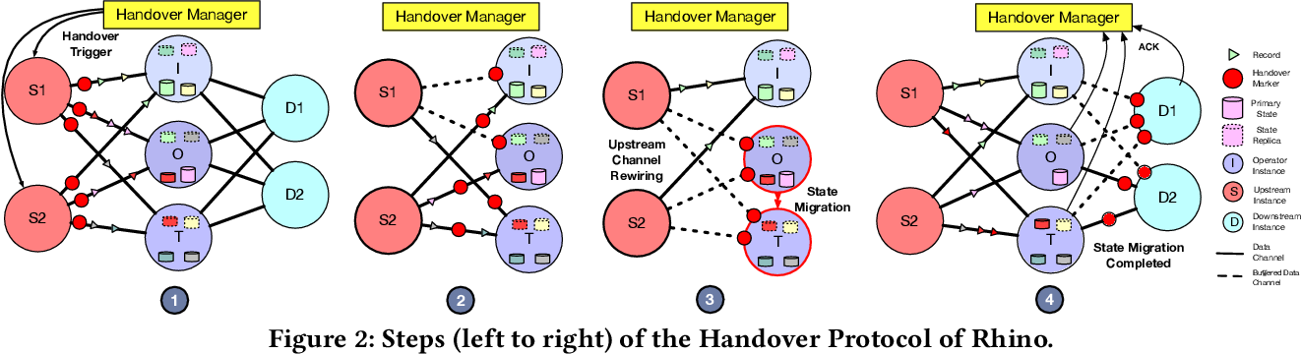

Slide 12
Replication Protocol
Block-centric and state-centric replication are two different approaches to replicating data in distributed systems, particularly in the context of stream processing engines.
Block-centric replication involves dividing the data into fixed-size blocks or chunks, and replicating these blocks across different nodes in the system. When a node needs to access a particular block of data, it fetches that block from a remote node that has a replica of it. This approach is particularly useful when the data is large and access patterns are random, as it can minimize the amount of network traffic required to access the data.
State-centric replication, on the other hand, involves replicating the entire state of a system or a subset of it, rather than dividing it into blocks. In this approach, each node maintains a local copy of the state, and updates it as needed based on incoming data. When a node needs to access the state of another node, it fetches the entire state from that node. This approach can be more efficient when the access patterns are predictable and there is a lot of data sharing between nodes.

Slide 13
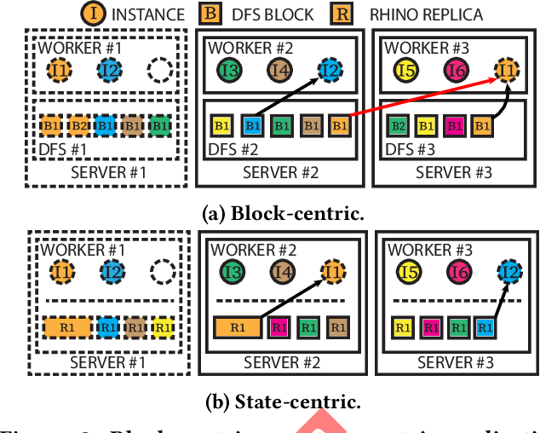
Replication Protocol

Slide 14
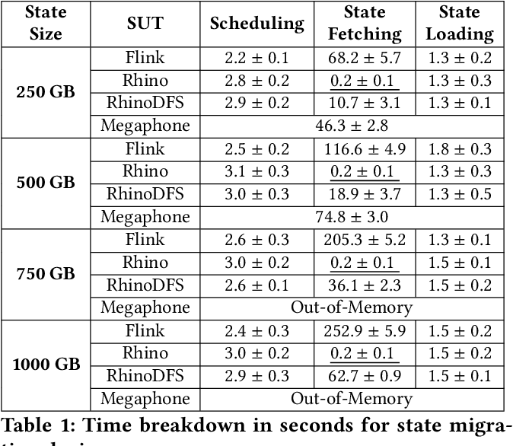
Rhino for Fault Tolerance

Slide 15
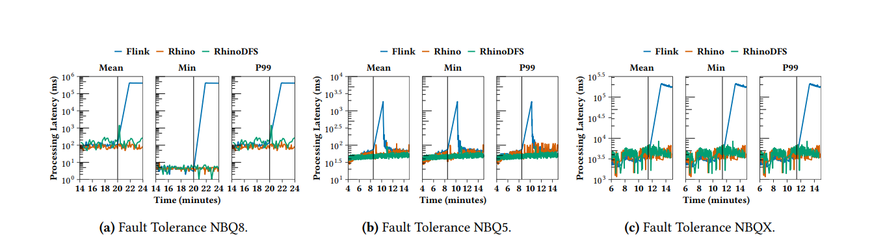
Average Latency Comparison for Fault Tolerance

Slide 16

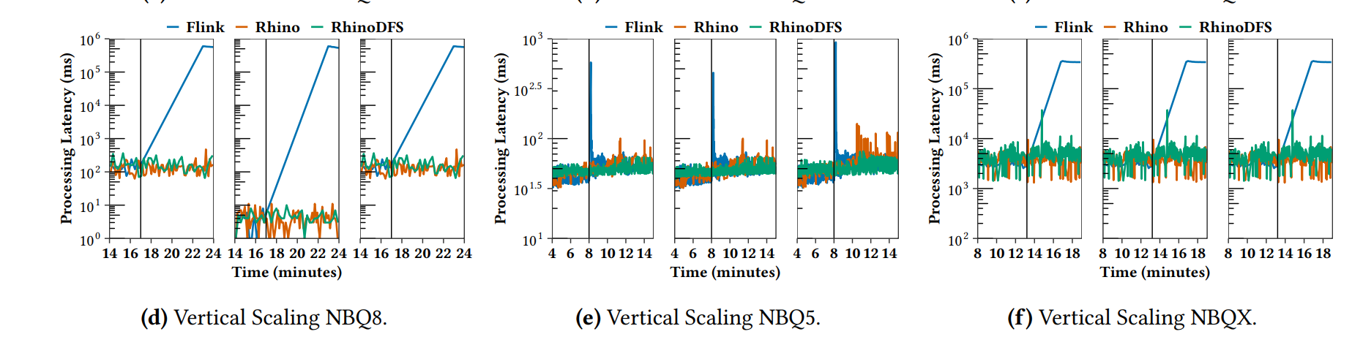
Average Latency Comparison for vertical scaling

Slide 17
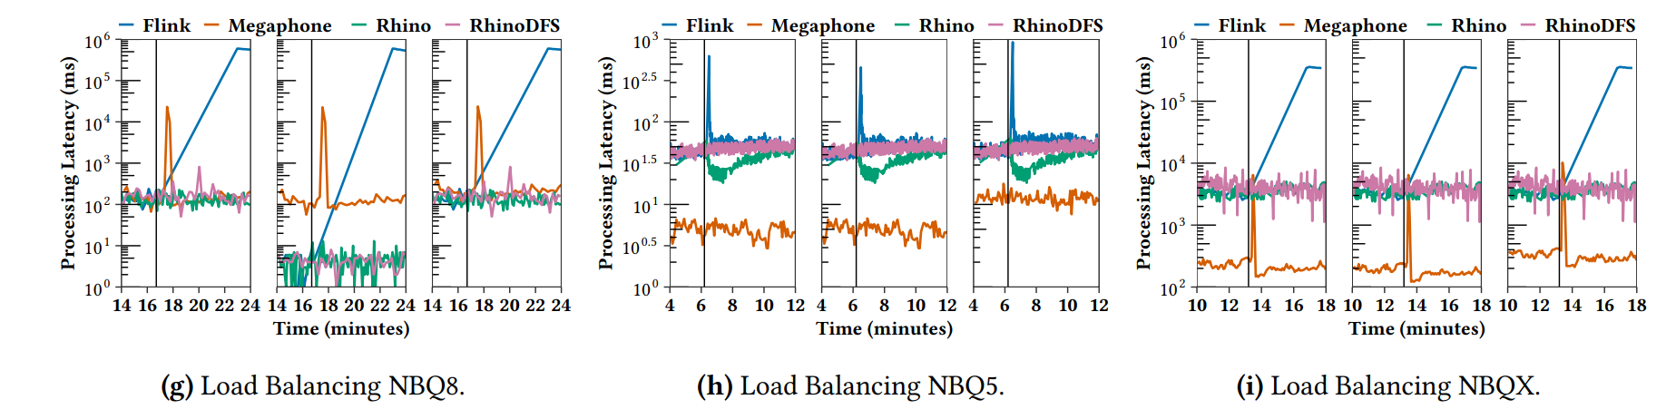
Average Latency Comparison for Load Balancing

Slide 18
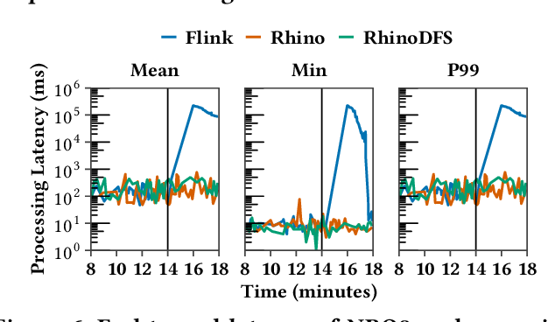
Migration under varying data rates

Slide 19
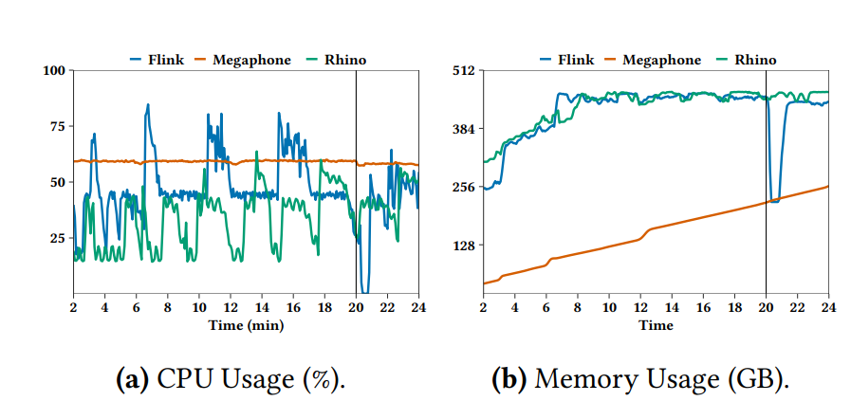
Comparison of resource utilization of Apache Flink and Rhino for NBQ8. The black line indicated when we perform a reconfiguration.

Slide 20
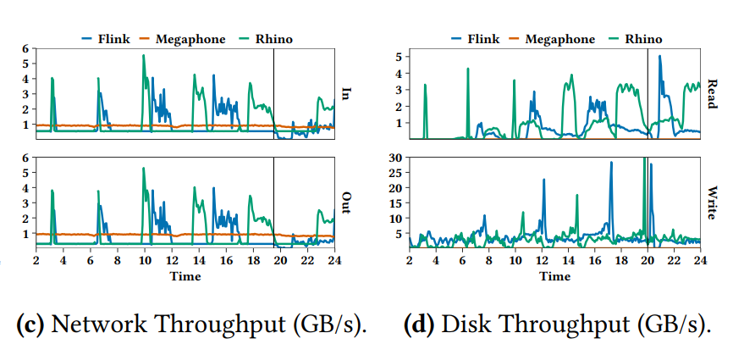
Comparison of resource utilization of Apache Flink and Rhino for NBQ8. The black line indicated when we perform a reconfiguration.

Slide 21
CONCLUSION
Rhino, a system library that enables fine-grained fault-tolerance, resource elasticity, and runtime optimizations in the presence of large distributed state
Rhino is 50x faster than Flink, 15x faster than Megaphone, and 11x faster than RhinoDFS in reconfiguring a query.
Moreover, Rhino shows a reduction in processing latency by up to three orders of magnitude after a reconfiguration.

